Slide 1
Wind power prediction using machine learning and deep learning
Jothsna Praveena Pendyala Mohana Uma Sai Manem
ADVISOR: DR. KHALID ABOALAYON
COURSE: MSDA3999 Summer II 2024

Slide 2
Table of Contents
Introduction
Problem Statement
Methodology
Data Collection
Exploratory Data Analysis (EDA)
Statistical/ Machine Learning Results
Results
Challenges
Lessons Learned & Future Work
Conclusion
Acknowledgments
Q&A
References

Slide 3
Introduction
Project Overview:
This project enhances wind power forecasting by comparing machine learning and deep learning models. A pipeline with cross-validation and hyperparameter tuning achieved an R² of 0.9667, outperforming deep learning. The study highlights machine learning pipelines as efficient alternatives, offering high accuracy in renewable energy forecasting.

Slide 4

Introduction
Motivation :
The motivation behind this project stems from the growing need for reliable wind power forecasting as renewable energy integration becomes increasingly vital. Accurate predictions help optimize grid stability, resource allocation, and energy management. By comparing traditional machine learning and deep learning methods, this study aims to identify effective, resource-efficient models that support scalable and accurate wind power forecasting, ultimately contributing to a more sustainable energy future.

Slide 5

Introduction
Objective:
The objective of this project is to evaluate and compare the performance of various machine learning and deep learning models in predicting wind power. The study focuses on determining whether well-tuned machine learning pipelines can achieve accuracy levels comparable to or exceeding deep learning models, ultimately identifying the most efficient and effective approach for wind power forecasting.

Slide 6

Project Beneficiaries
Wind Farm Operators: Improve operational efficiency with accurate wind power predictions.
Grid Managers: Enhance grid stability and optimize energy distribution strategies.
Policymakers: Support decision-making for renewable energy initiatives and regulations.

Slide 7
Problem Statement
1. Clear Statement:
We aim to improve the accuracy of wind power generation forecasts using advanced machine learning and deep learning models. Accurate predictions are vital for integrating wind energy into power grids and optimizing energy production.
2. Importance:
Economic Impact: Better forecasts reduce reliance on costly backup power, enhancing the profitability of wind farms.
Environmental Impact: Accurate predictions help maximize renewable energy usage, contributing to lower greenhouse gas emissions.

Slide 8
Methodology: Data Collection
The dataset was sourced from the SCADA system of the Esenkoy wind power plant.
It includes key internal metrics such as wind speed, wind direction, theoretical power, and active power.
This comprehensive dataset is crucial for improving the accuracy of wind power predictions by providing rich, relevant information.
The data presented in this study are openly available in [Kaggle] at [https://www.kaggle.com/datasets/berkerisen/wind-turbine-scada-dataset]and [renewables.ninja] at [https://www.renewables.ninja]

Slide 9

Preprocessing steps:
°
Datetime Feature Extraction: Additional features like hour and month were extracted from the datetime column to capture seasonal and daily variations.
Lagged Features: Introduced lagged features to account for temporal dependencies, allowing the model to utilize information from previous time steps.
Outlier Detection: Outliers were calculated and managed to maintain data integrity and ensure robust model performance.

Slide 10

Exploratory Data Analysis

Slide 11
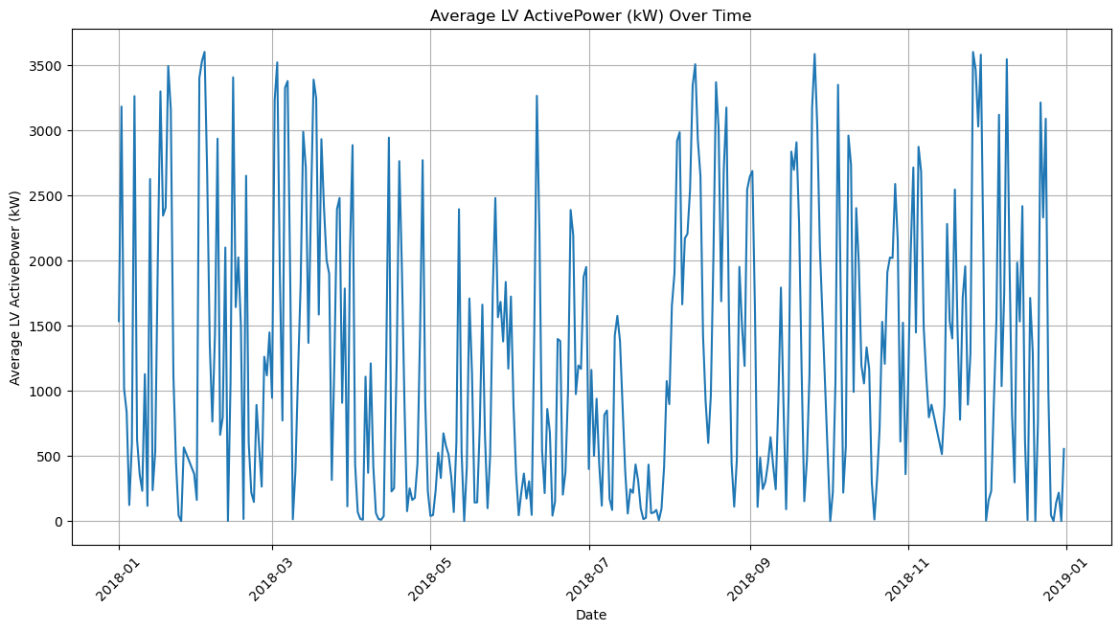
Exploratory Data Analysis (EDA)
Active Power VS time

Slide 12
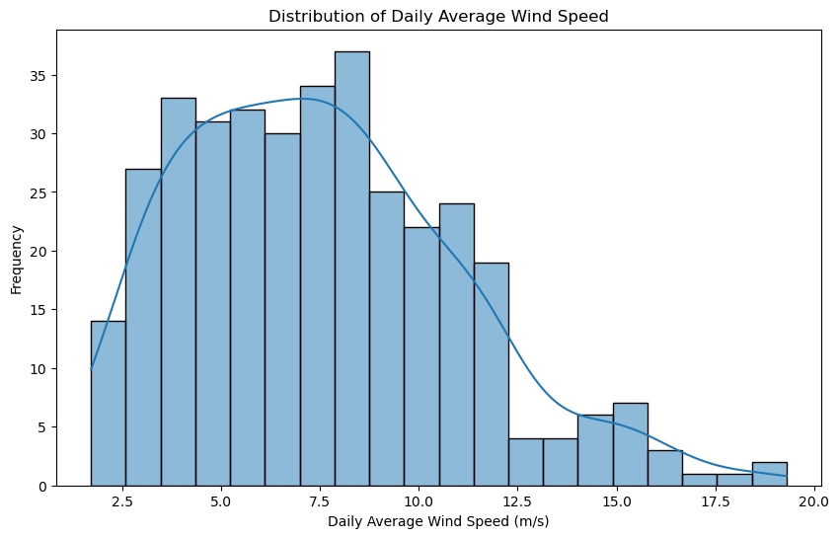
Exploratory Data Analysis (EDA)
Average Power VS Wind Speed

Slide 13
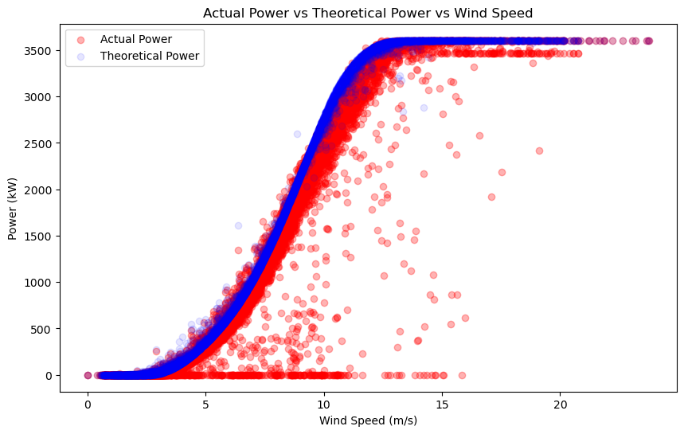
Exploratory Data Analysis (EDA)
Active VS Theoretical VS Wind Speed

Slide 14
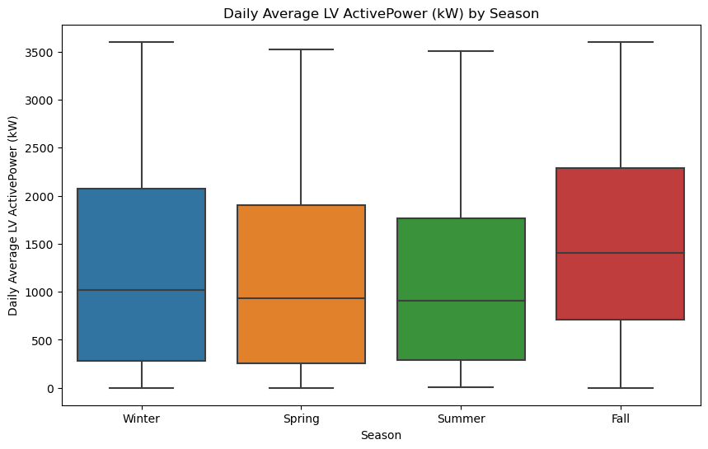
Exploratory Data Analysis (EDA) Box Plot
Average Power VS Season

Slide 15
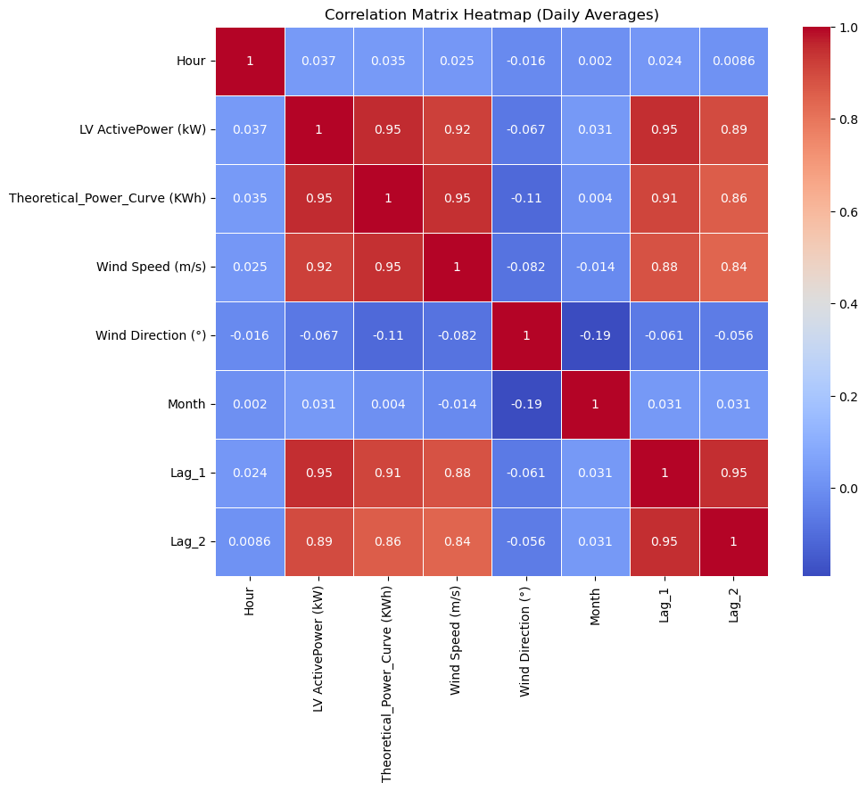
Heatmap

Slide 16
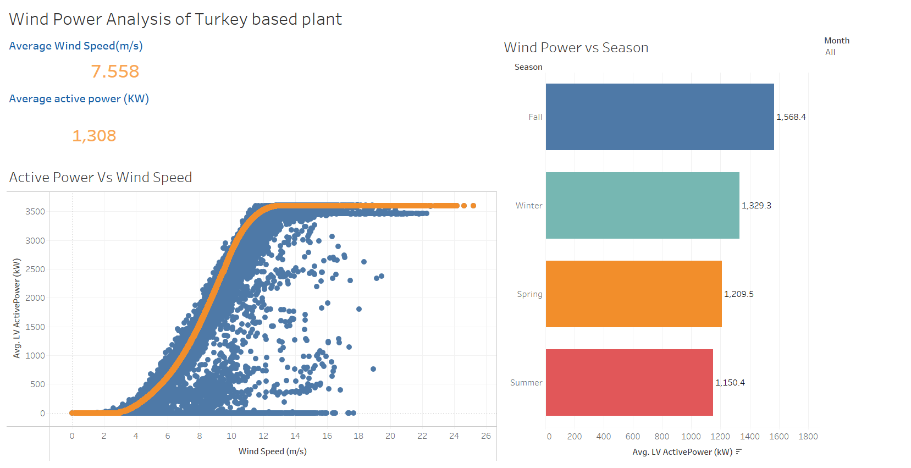
Tableau Dashboard
TableauDashboard

Slide 17

Machine Learning Models Implementation
Linear Regression
XGBoost
Xgboost Pipeline with Cross Validation
Ensemble Method(XGBoost and Random Forest)

Slide 18
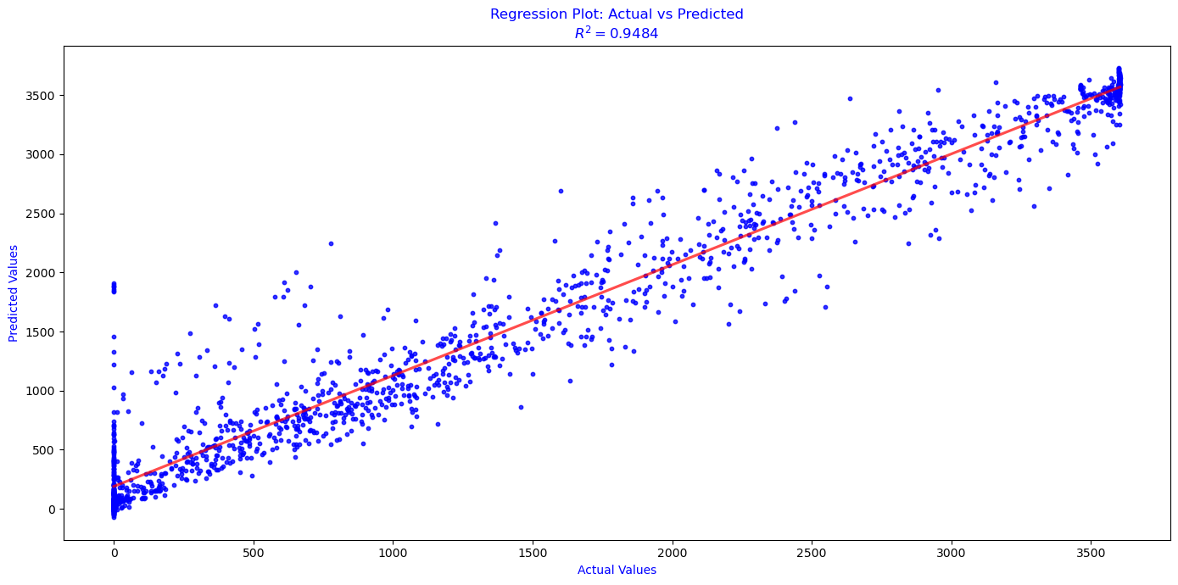
Linear Regression Plot
The plot indicates that the model is performing well, with predictions closely matching the actual values, as indicated by both the alignment of points along the regression line and the high 𝑅2score.

Slide 19
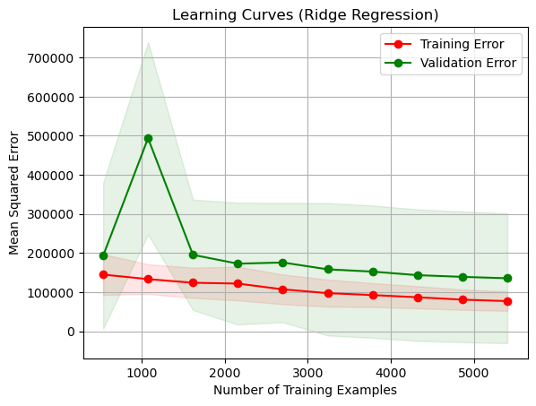
Learning Curves
Comparison b/w training error and validation errors

Slide 20
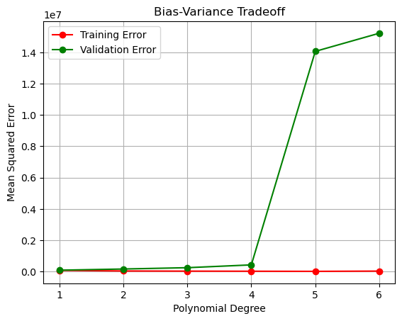
Bias-Variance Tradeoff
The graph shows that increasing the polynomial degree beyond a certain point (degree 3) results in significant overfitting, where the model's variance dominates, making it less reliable on unseen data.

Slide 21
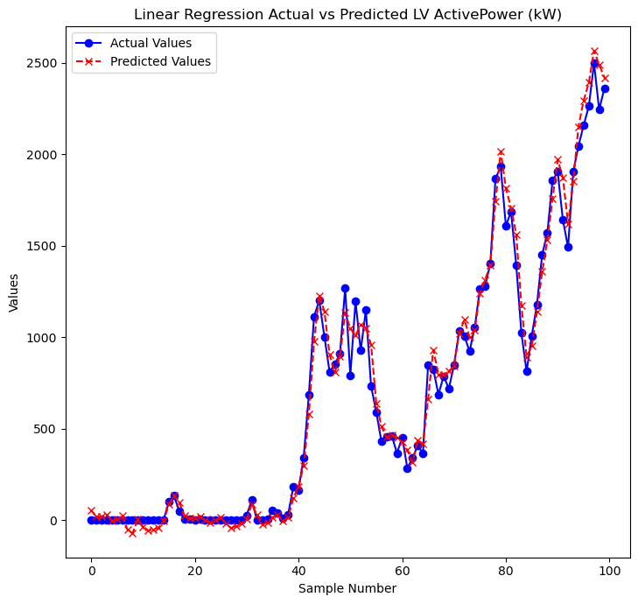
Key Results and Findings
Linear Regression: Baseline model to establish a simple relationship between wind speed and power output.

Slide 22
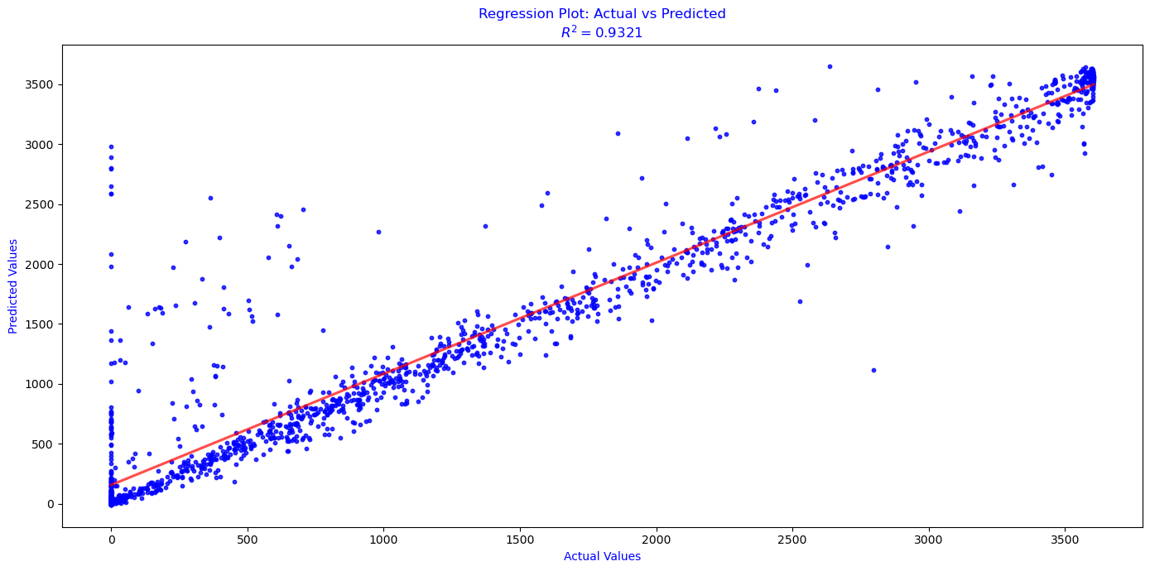
XG BOOST
The model remains reliable, but its predictive power is marginally reduced compared to the Linear Regression (with an 𝑅2 of 0.9484).
The slight increase in deviations could indicate minor overfitting or greater prediction error at certain ranges.
Here training R2 score is 0.99 whereas testing R2 is 0.93

Slide 23
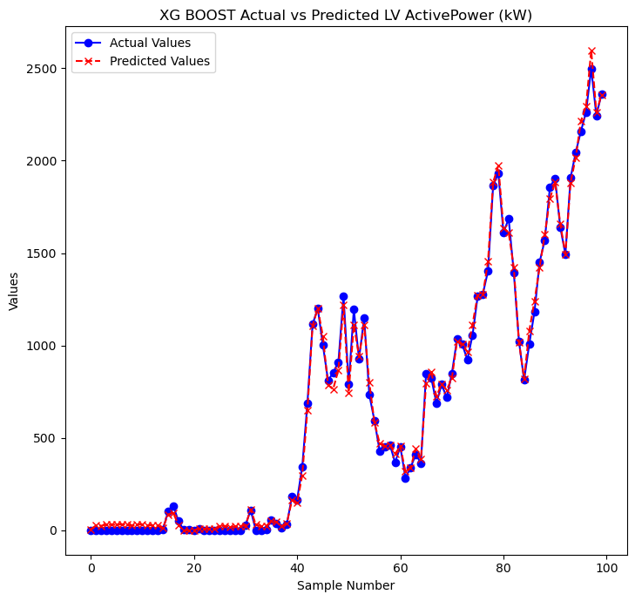
XGBoost

Slide 24
XGBoost Pipeline with Cross validation
To prevent overfitting, an XGBoost pipeline combined with cross-validation is highly effective. The pipeline ensures consistent data preprocessing, including scaling while the cross-validation technique divides the data into multiple folds to train and test the model iteratively.
Cross-validation helps in evaluating the model's performance across different subsets of data, offering a more accurate estimate and better generalization to unseen data. By fine-tuning the model's hyperparameters during this process, you can significantly reduce overfitting, leading to a robust and reliable model.

Slide 25
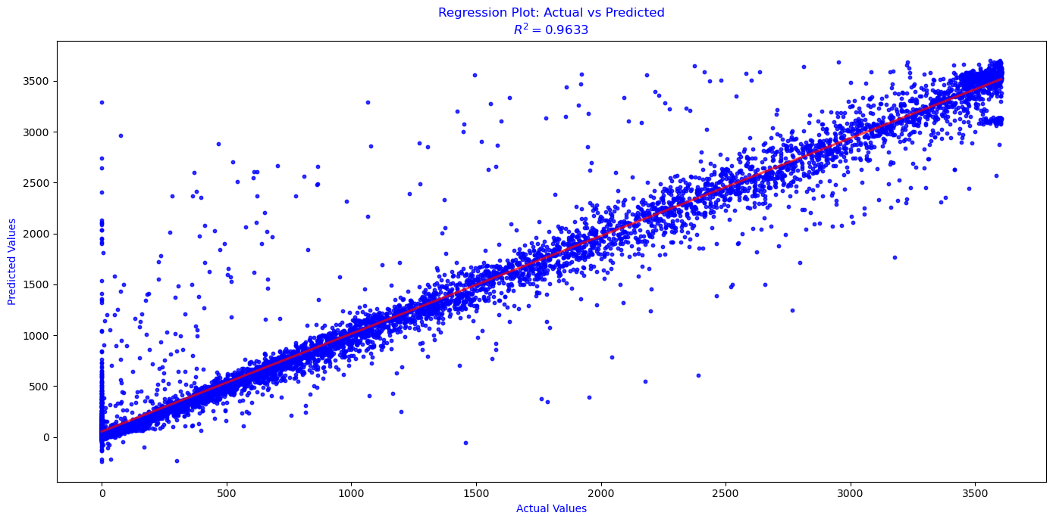
XGBoost Pipeline with Cross validation
This regression plot compares actual values to predicted values which indicating the relationship between the actual and predicted values. The plot shows a strong positive correlation, as evidenced by the R2 value of 0.9633, which suggests that approximately 96.33% of the variability in the actual values can be explained by the model's predictions.

Slide 26
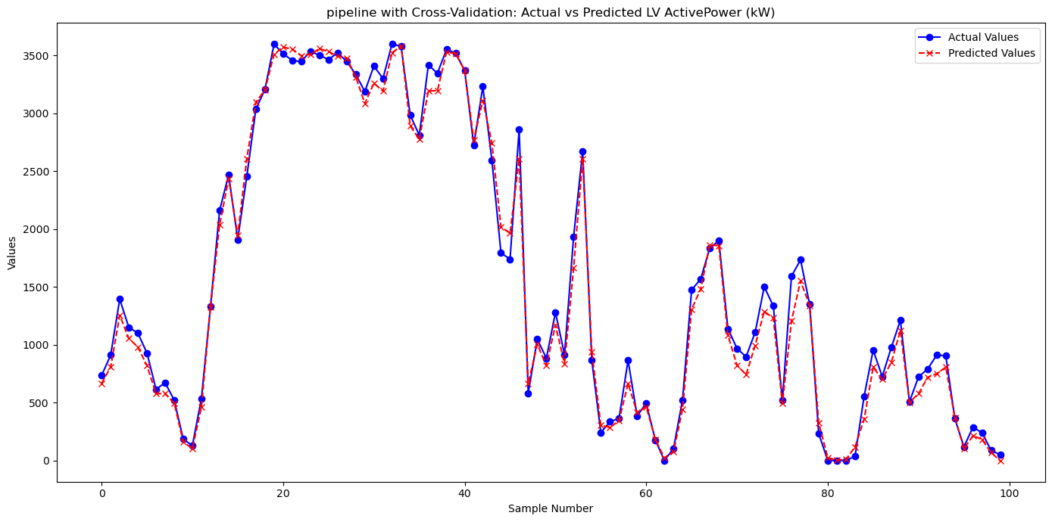
XGBoost Pipeline with Cross validation
Implemented a pipeline combining scaling, and model training.
Utilized cross-validation to ensure robust performance across different data splits and prevent overfitting.

Slide 27
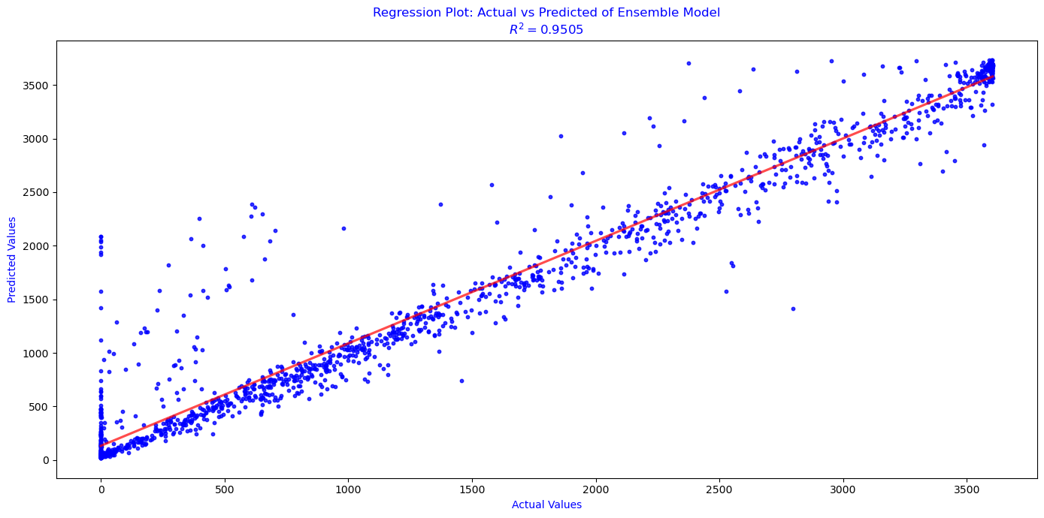
Ensemble method(Random Forest and XGBoost):
The plot shows a strong correlation between the actual and predicted values, with an 𝑅2 of 0.9505, indicating that 95.05% of the variability in the actual values is explained by the ensemble model's predictions.

Slide 28
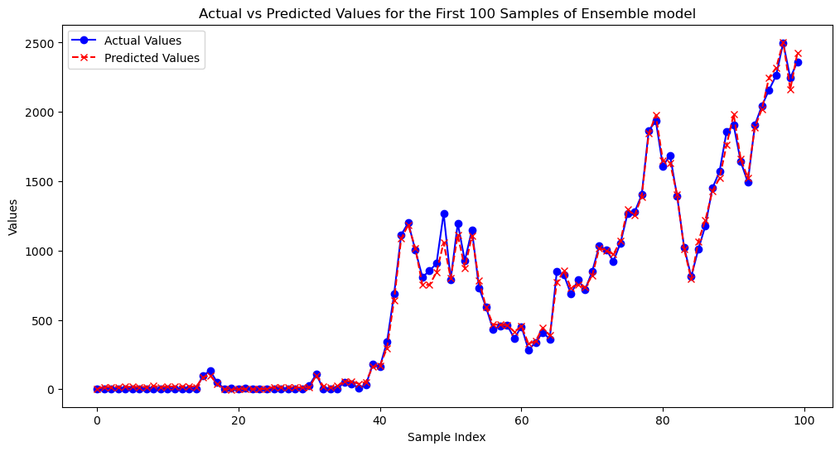
Ensemble method(Random Forest and XGBoost):
Applied ensemble techniques for better handling of non-linear relationships and feature importance analysis.

Slide 29
Machine Learning Results
Model | R2 | RMSE | MAE | MSE
Linear Regression | 0.95 | 0.24 | 0.14 | 0.06
XG Boost | 0.93 | 0.26 | 0.12 | 0.07
Pipeline with CV | 0.96 | 0.20 | 0.08 | 0.04
Ensemble method | 0.95 | 0.22 | 0.11 | 0.05

Slide 30
Models Performance without lag features
Model | R2 | RMSE | MAE | MSE
Linear Regression | 0.89 | 0.35 | 0.12 | 0.18
XGboost | 0.89 | 0.33 | 0.11 | 0.14
Pipeline with cv | 0.92 | 0.30 | 0.09 | 0.12
Ensemble | 0.91 | 0.32 | 0.10 | 0.14

Slide 31

Deep Learning Models
1. Artificial Neural Networks(ANN)
Single hidden layer
Multiple Hidden layer
2. Long Short Term Memory(LSTM)

Slide 32
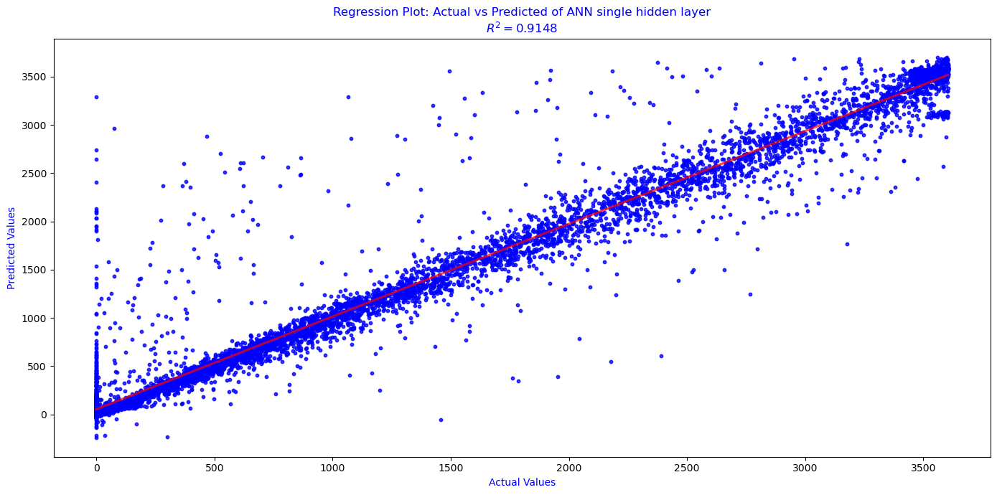
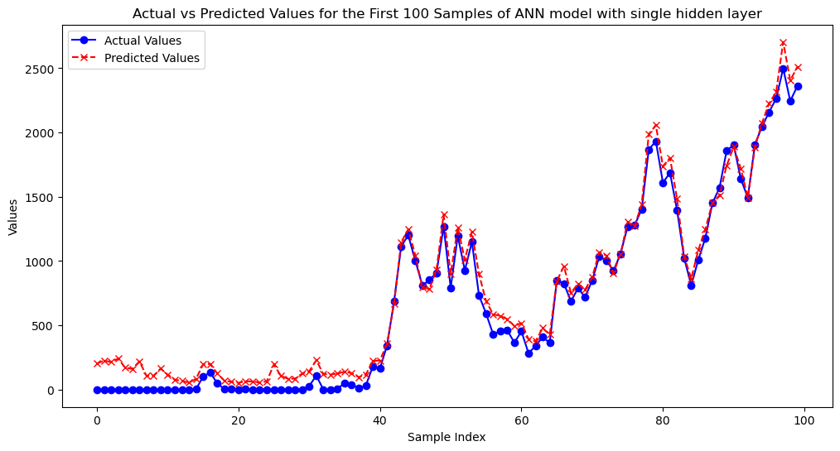
ANN models 1.Single Hidden Layer

Slide 33

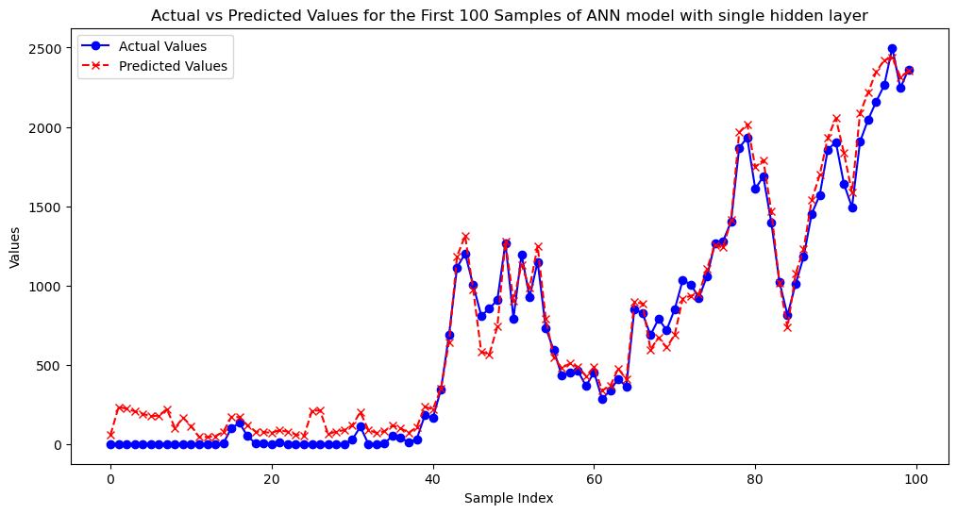
2. Multiple Hidden Layers

Slide 34

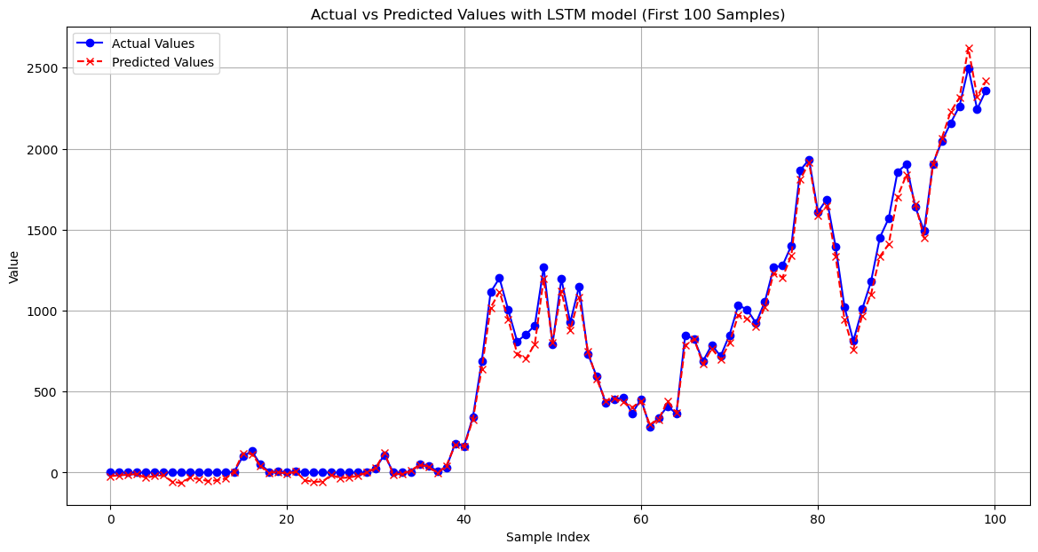
LSTM Model

Slide 35
Deep Learning Results
Model | R2 | RMSE | MAE | MSE
ANN with Single Hidden layers | 0.9148 | 0.302 | 0.1635 | 0.0912
ANN with Multiple Hidden Layers | 0.9111 | 0.3085 | 0.1701 | 0.0952
LSTM | 0.92 | 0.1 | 0.05 | 0.01

Slide 36
APP

Slide 37

Challenges
Challenge 1:
Overfitting: XGBoost model performed exceptionally well on training data but exhibited poor performance on testing data, indicating overfitting.
Solution:
Cross-Validation: Used cross-validation techniques to better assess model performance and reduce overfitting. Implemented a 10-fold cross-validation approach to ensure robustness.

Slide 38
Challenges
Optimizing Hyperparameters: Selecting the optimal hyperparameters for models, especially for complex algorithms like XGBoost, proved challenging due to the large search space.
Solution:
Automated Tuning: Used automated hyperparameter tuning techniques such as grid search and random search to systematically explore and select the best hyperparameters.
Pipeline Integration: Implemented pipelines for consistent preprocessing and model tuning, improving efficiency and reproducibility.
Challenge 2:

Slide 39
Challenges
Challenge3:
Capturing Long-Term Dependencies: LSTMs, though effective for time series data, initially struggled with capturing long-term dependencies and seasonality in the data.
Even Machine algorithms faced difficulty in capturing dependencies.
Solution:
Feature Engineering: Enhanced feature engineering by incorporating lagged features to provide more context to the models.

Slide 40
Lessons Learned
Feature Engineering: Adding temporal and lagged features enhanced model accuracy, particularly for time series data.
Model Selection: Effective hyperparameter tuning and model selection are essential for optimal results. Used various models and tuning techniques to find the best configurations.
Overfitting: Applied cross-validation and regularization to ensure models generalize well and avoid overfitting.
Resource Management: Managed computational resources effectively, using cloud services and GPUs for efficient training.

Slide 41

Lessons Learned
Unexpected Discoveries:
Performance Variability: Random seed settings affected model performance. Consistent seeding and evaluation improved reliability.
Cross-Validation: Provided more reliable performance metrics, especially for models like XGBoost.

Slide 42
Future Work
Suggestions for Future Research:
Feature Engineering: Explore additional features and external data sources for better accuracy.
Advanced Models: Investigate new neural network architectures and hybrid models.
Real-Time Monitoring: Develop systems for real-time predictions and updates.
Other Energy Sources: Apply methods to other renewable energy sources for broader applications.

Slide 43
Future Work
Extensions to the Project:
Decision Support Systems: Integrate models into operational planning tools.
Long-Term Analysis: Conduct extended performance reviews and periodic model updates.
Collaborative Research: Partner with experts for validation and new research opportunities.

Slide 44
Conclusion
The findings reveal that the Pipeline with Cross-Validation, when combined with proper hyperparameter tuning, performs exceptionally well, achieving an R² of 0.9667, surpassing or matching the accuracy of deep learning models. The best-performing neural network, LSTM, reached an R² of 0.92. These results suggest that well-tuned machine learning pipelines can serve as a robust and efficient alternative to deep learning models, offering high accuracy in wind power forecasting

Slide 45
Acknowledgments
We would like to extend my heartfelt gratitude to Dr. Khalid Aboalayon for his invaluable guidance and support throughout this project. His feedback have greatly contributed to the successful completion of this work

Slide 46
Q&A
Open the floor for questions from the audience

Slide 47
References
Karaman, Ö. A. (2023). Prediction of wind power with machine learning models. Applied Sciences, 13(20), 11455. https://doi.org/10.3390/app132011455
Yang, T., Yang, Z., Li, F., & Wang, H. (2024). A short-term wind power forecasting method based on multivariate signal decomposition and variable selection. Applied Energy, Volume, Issue, Article 122759. https://doi.org/10.1016/j.apenergy.2024.122759
Yetis, Y.; Tehrani, K.; Jamshidi, M. Wind Speed Forecasting using Machine Learning Approach based on Meteorological Data case study. Energy Environ. Res. 2022, 12, 2
Surakhi, O., Zaidan, M. A., Fung, P. L., Motlagh, N. H., Serhan, S., AlKhanafseh, M., Ghoniem, R. M., & Hussein, T. (2021). Time-lag selection for time-series forecasting using neural network and heuristic algorithm. Electronics, 10(20), Article 2518. https://doi.org/10.3390/electronics10202518

Slide 48
Thank you

